Slide 1
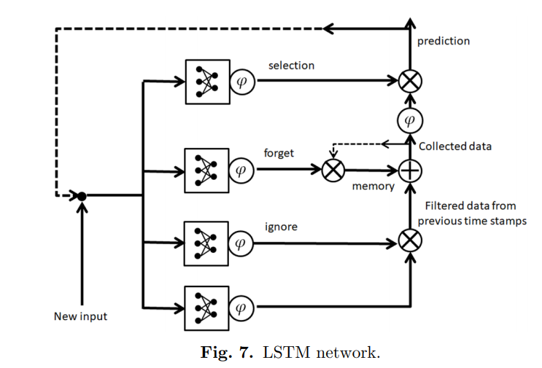
Long Short Term Memory(LSTM)
LSTM an artificial recurrent neural network (RNN) used in the field of deep learning.
LSTM are very good at holding long term memories.
LSTM are widely used for sequence perdition problems and have proven to be extremely effective.
The reason they works so well is because LSTM is able to store past informant that is important, and forget the information that is not.

Slide 2
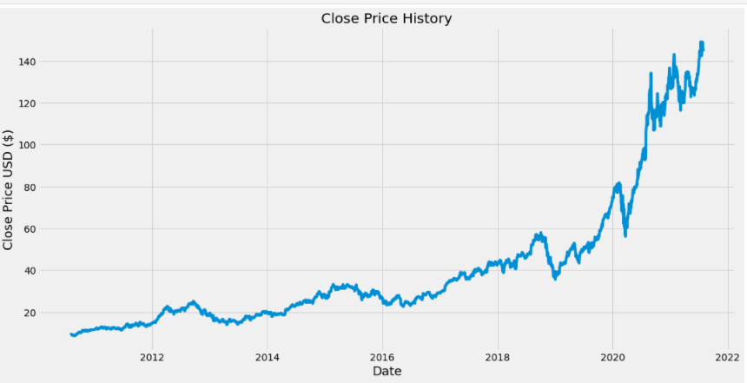
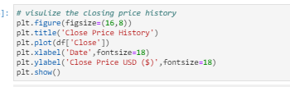
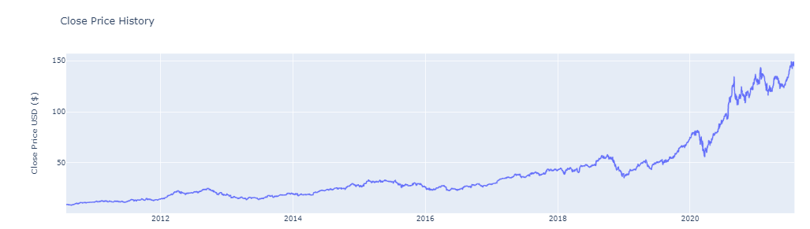
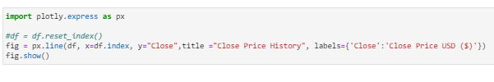
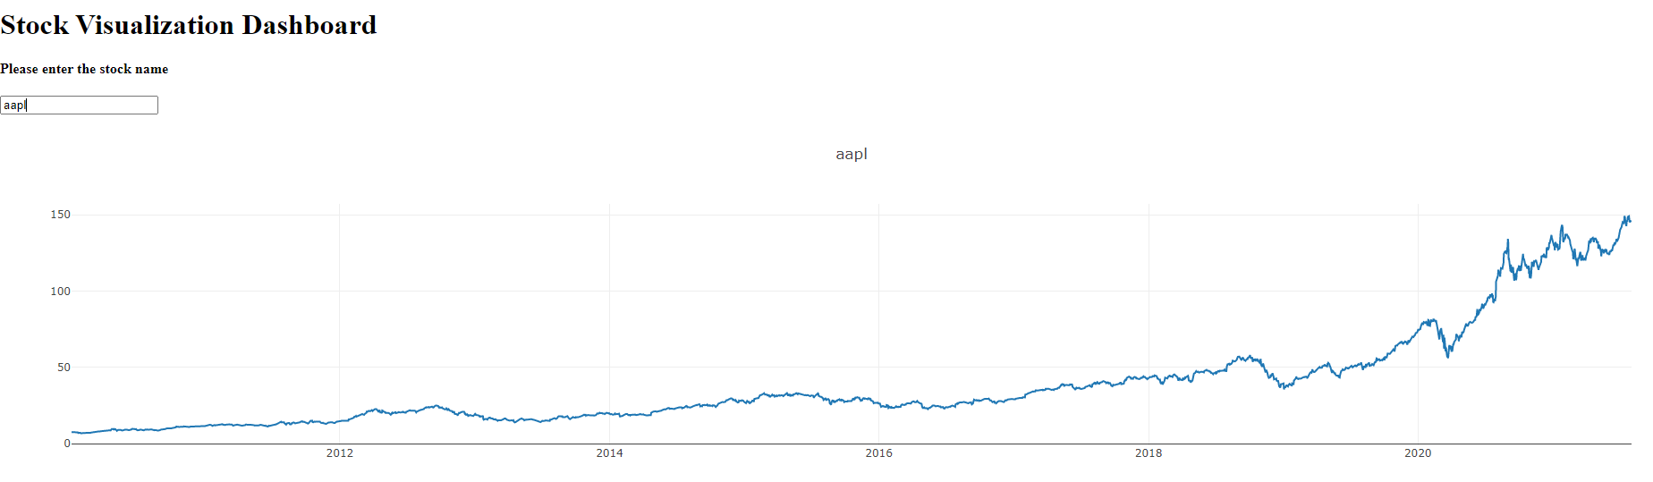
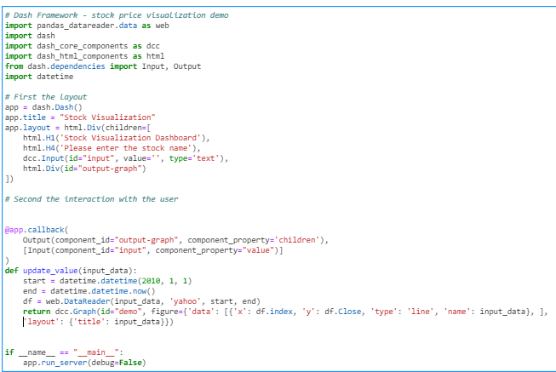
Apple stock over 10 years
Graph using Matplotlib
Graph using plotly express
Graph on Dash

Slide 3
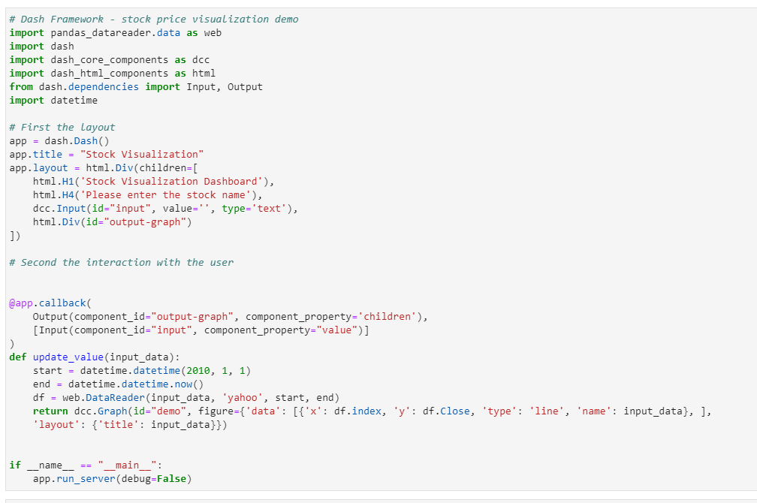
Dash code

Slide 4
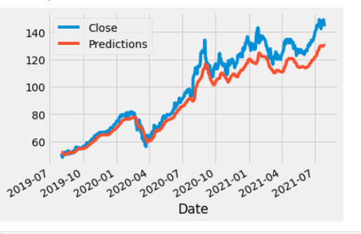

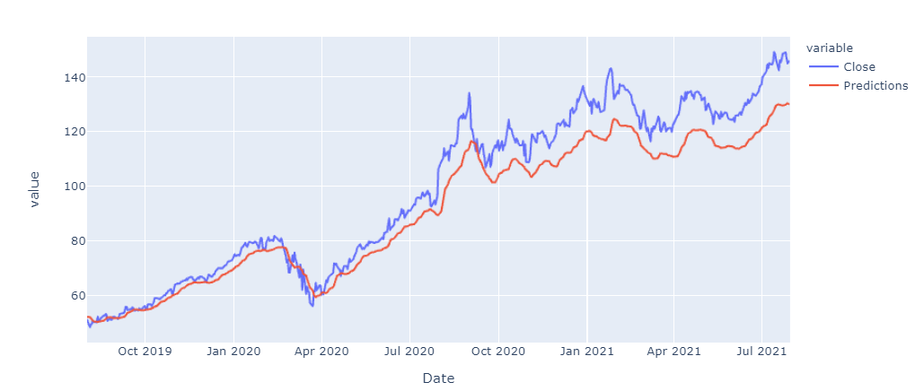

Real closing price vs. predicted price
Graph using Matplotlib
Graph using plotly express
Graph on Dash

Slide 5
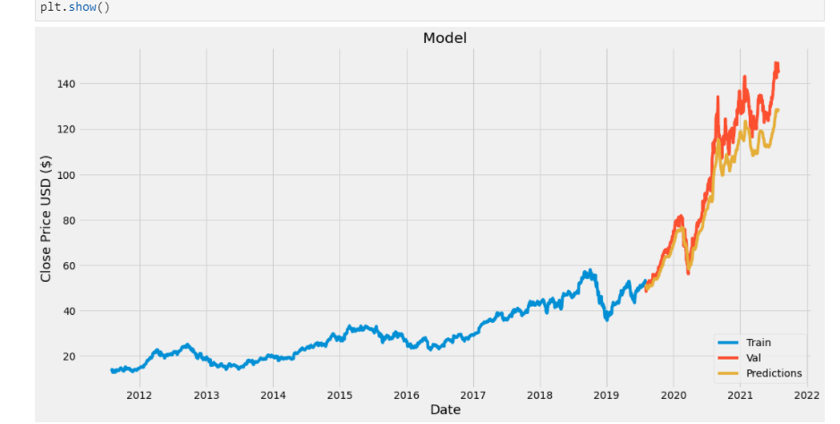
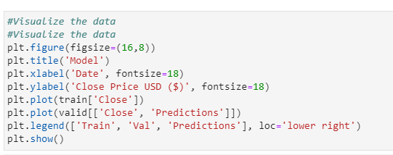
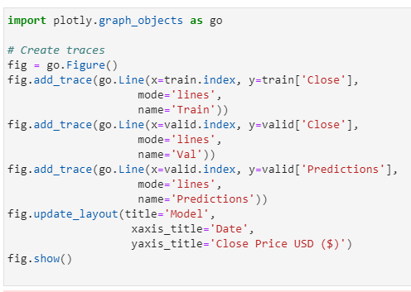
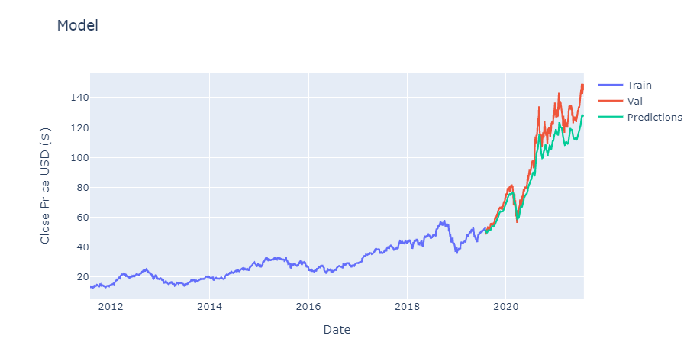
Apple stock: training (train) real (valid) and precited (predictions)
Graph using Matplotlib
Graph using plotly express

